Slide 1
Library Management System
project report
on
Developed By
Anand Vijay Rajsri (00120807717)

Slide 2
SCOPE OF PROJECT
To make the existing system more efficient.
To provide a user friendly environment where user can be serviced better.
Make functioning of library faster.
When computerized system is not implemented file is always lost because of human environment.
When there is no computerized system there is always a difficulty in searching of records if the records are large in number.

Slide 3
REQUIREMENTS
The Library Management System shall be required to maintain information about its users and books.
It shall store databases for students, staff and books.
The student database stores information about a student’s roll no/ID, name, phone no, email and book count.
The book database stores information about a book title, author, ISBN no, quantity.
The teacher database stores information about a staff id, name, password.

Slide 4
DRAWBACKS OF PRESENT SYSTEM
File lost
Difficult to search record
Space consuming
Cost consuming
Time consuming
Information about issue/return of the books are not properly maintained.
No central database can be created as information is not available in database.

Slide 5
Project Profile
Improvement in control and performance.
Save Cost and Time.
More Accuracy.
Speed improvement.
Data inconsistency.
Better error handling.
Administrator will immediately acknowledged with error message.
Book search with quantity can be performed.
The System will handle the maintenance of data .

Slide 6
SOFTWARE REQUIREMENTS
Operating system Windows 7 is used as the operating system as it is stable and supports more features and is more user friendly.
Database “SQLite” is used as database as it easy to maintain and retrieve records by simple queries which are in English language which are easy to understand and easy to write.
Development tools and Programming language “PYTHON” is used to write the whole code and develop.

Slide 7
HARDWARE REQUIREMENTS
Intel core i3 2nd generation is used as a processor because it is fast than other processors and provide reliable and stable and we can run our pc for long time. By using this processor we can keep on developing our project without any worries.
Ram 1GB is used as it will provide fast reading and writing capabilities and will in turn support in processing.
Hard disk space minimum 3 GB for database usage for future

Slide 8
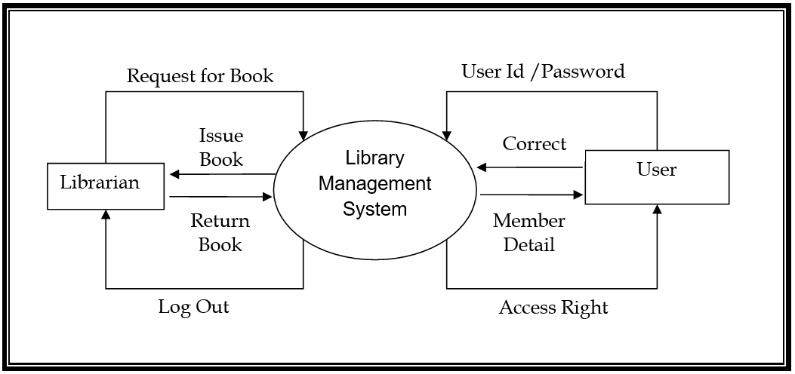
DATA FLOW DIAGRAMS

Slide 9
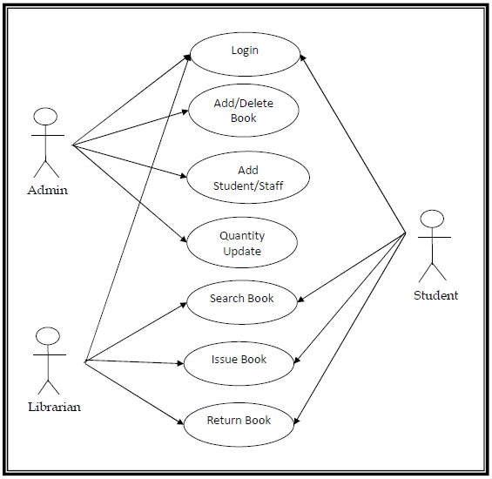
Use Case Diagrams

Slide 10
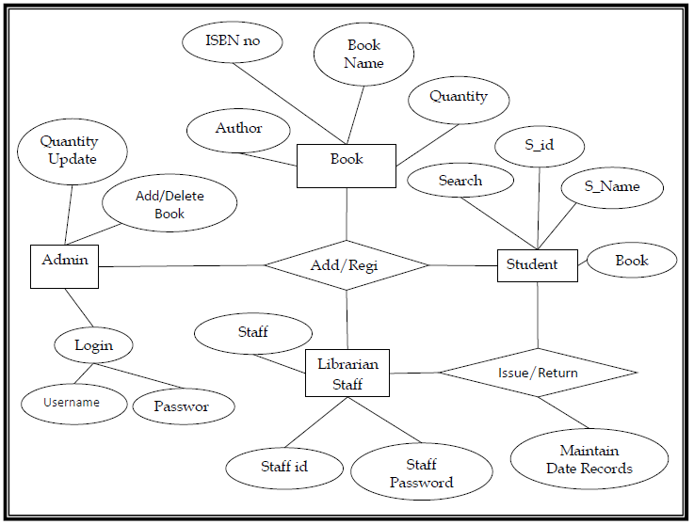
Entity Relationship Diagram

Slide 11
MODULES
Welcome Window
Login Window
Issue Book
Return Book
Add Book
Delete Book
Update Quantity
Add Student
Add Staff

Slide 12
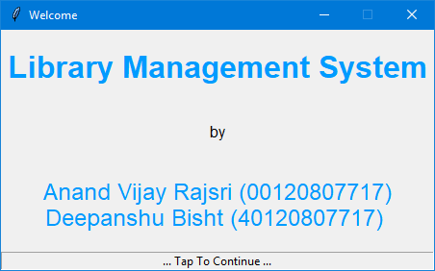
Screenshot For Welcome Window

Slide 13
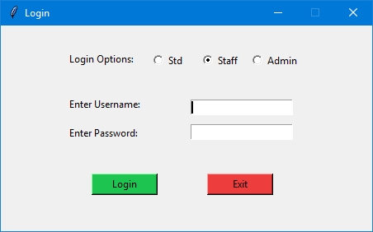
Screenshot for Login Window

Slide 14
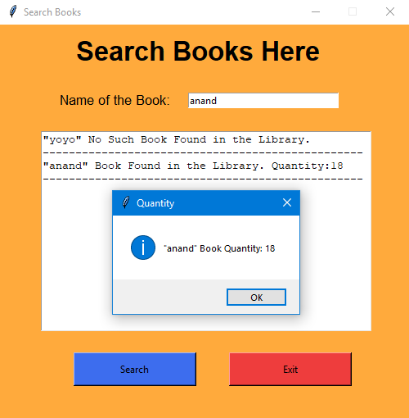
Screenshot for Student Search Window

Slide 15
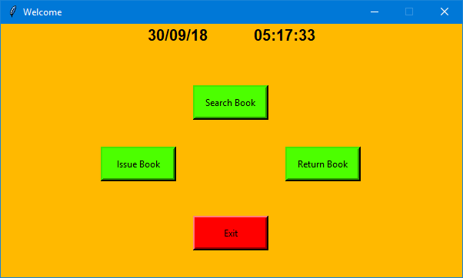
Screenshot for Staff Login Window

Slide 16
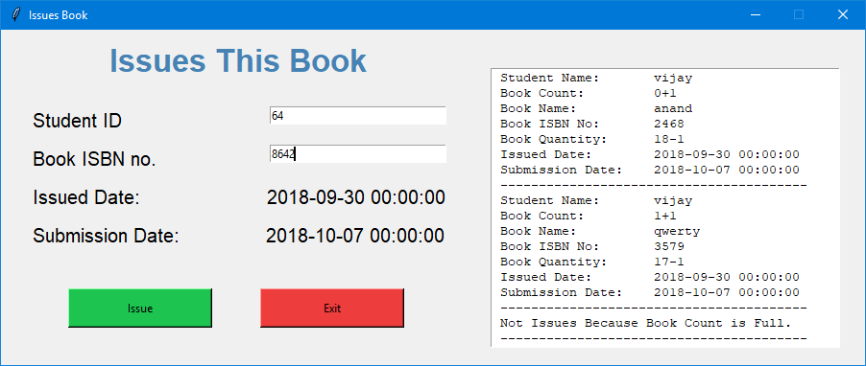
Issue Book

Slide 17
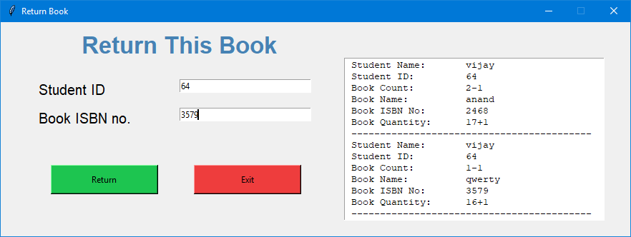
Return Book

Slide 18
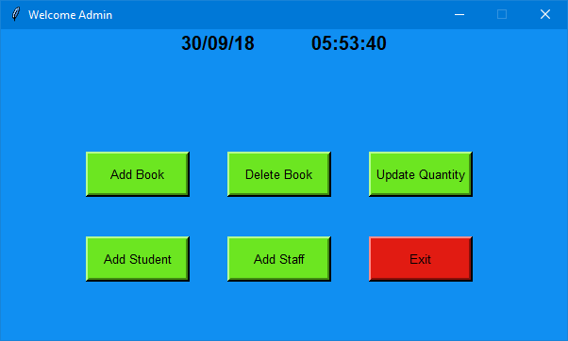
Admin login Into System

Slide 19
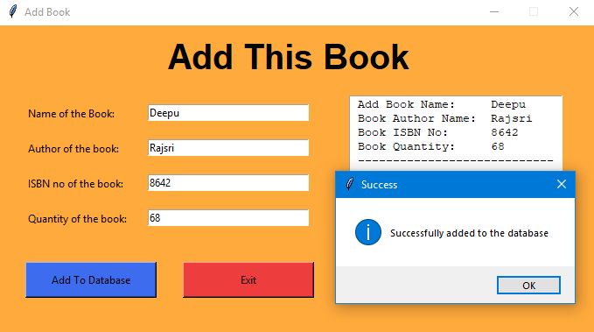
Add Book Window

Slide 20
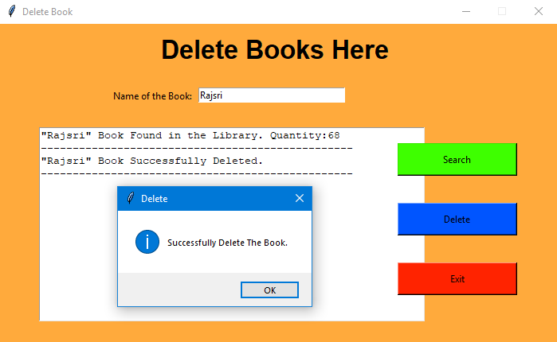
Delete Book Window

Slide 21
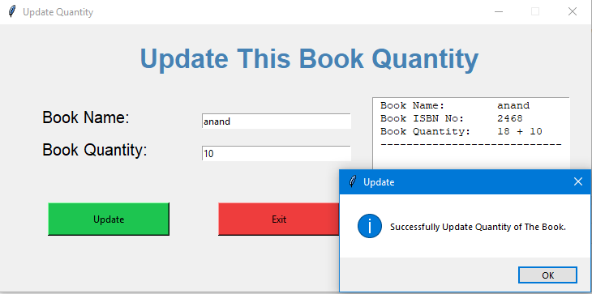
Update Quantity Window

Slide 22
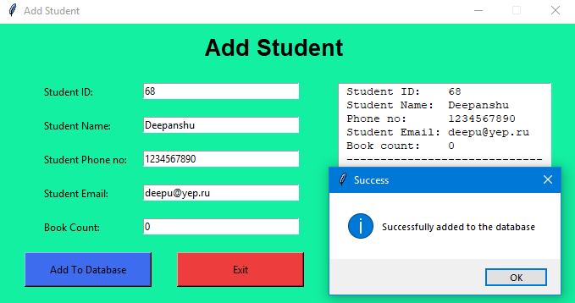
Add Student Window

Slide 23
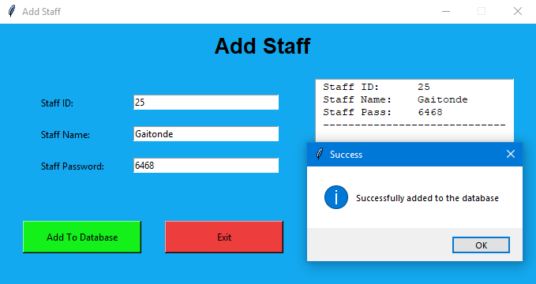
Add Staff Window

Slide 24
hidden features
Show Live Time.
Student Book Count.
Input And Database Exception Hand.
Delete Book Module First Search Book In Database.
Quantity Update Module Show Database Book Quantity.
Search Module Can Also Show Database Book Quantity.
Admin Login And Password Save In Program Code, Not In Database.
The book are present in the library but quantity is 0 then the book is not issue.
Software Can Save The Issue Book Record In Database And File System.
In File System File Are Save In Txt Format With The Name Is, Book ISBN Number.

Slide 25
Future Enhancements
In any system there is always chance for its enhancement and extension.
This system can also be enhanced with the change facilities. Also with the progress of the Fashion Design system can also be enhance in future.
More facilities can be added to the system for its growth.
There is always scope for enhancements in any system, especially in the ever –changing world of computers.
The Fashion design System can also be modified according to the feature requirements the advancement of the technology.

Slide 26
Bibliography
Books
➢ Software Engineering 3rd Edition (K. K. Aggarwal)
➢ Fundamentals of Database System Seventh Edition (Ramez Elmasri, Shamkant B. Navathe)
➢ Python The Complete Reference (Martin C. Brown)
➢ Using SQLite (Jay A. Kreibich)
Websites
✓ https://www.w3schools.com/python/
✓ https://www.tutorialspoint.com/sqlite/
✓ https://www.tutorialspoint.com/dbms/
✓ http://www.w3schools.com/sql/sql_update.asp

Slide 27
thank you

